Slide 1

GOING META
Ruby Metaprogramming Idioms
Will Gorman

Slide 2
REPETITIVE
REPETITIVE
RETEPIVITE
REPETITIVE

Slide 3
Copy
&
Paste

Slide 4
Metaprogramming

Slide 5
i just like ruby.
Notes:
I just like ruby and I like how it makes me feel more productive as a developer

Slide 6

Not just for wizards

Slide 7
Definition
Object Model Overview
Examples of Techniques
Antipatterns
This is the only slide with bullet points

Slide 8
CODE
CODE
THAT WRITES

Slide 9

I GOT THIS

Slide 10
klass = "Foo"
code = <<-CODE
class #{klass}
def method
puts "Why?"
end
end
CODE
File.open("#{klass}.rb", 'w') { |f|
f.write(code)
}

Slide 11

A
O
BJECT MODEL

Slide 12
What happens
when we call a method

Slide 13
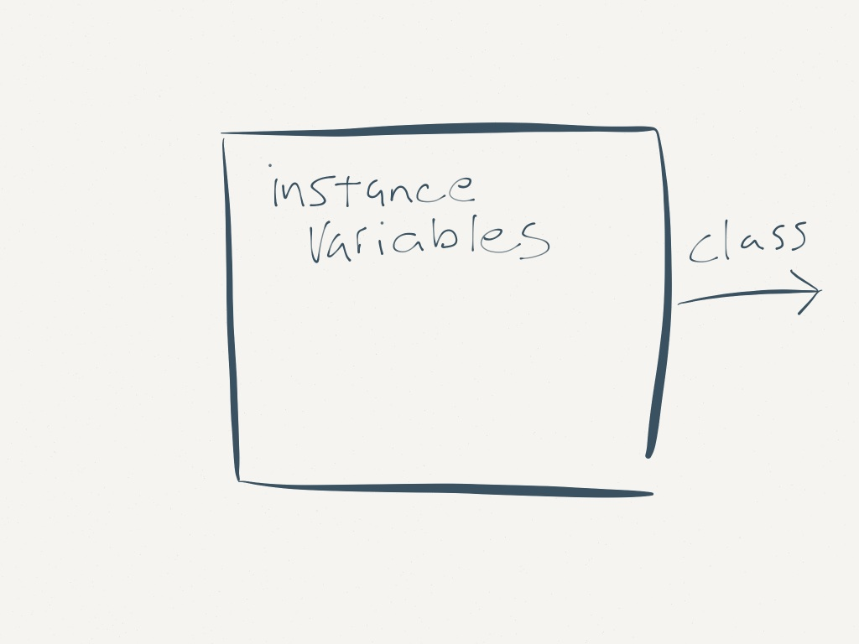

Slide 14
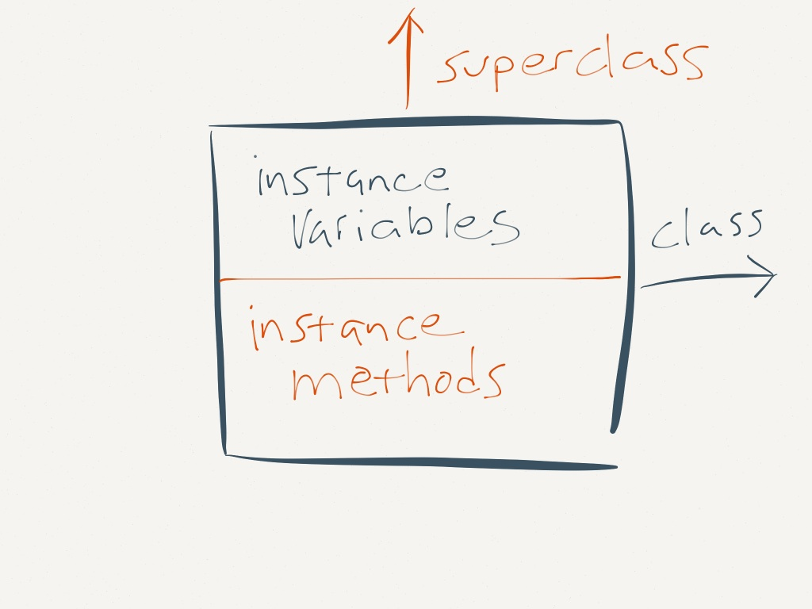

Slide 15
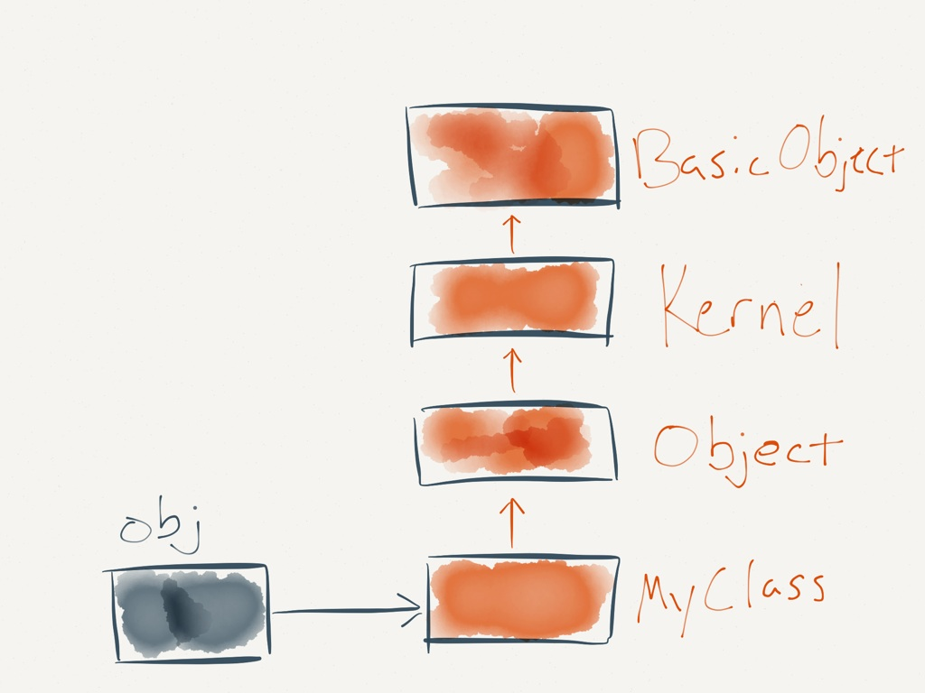

Slide 16
Open
Classes

Slide 17
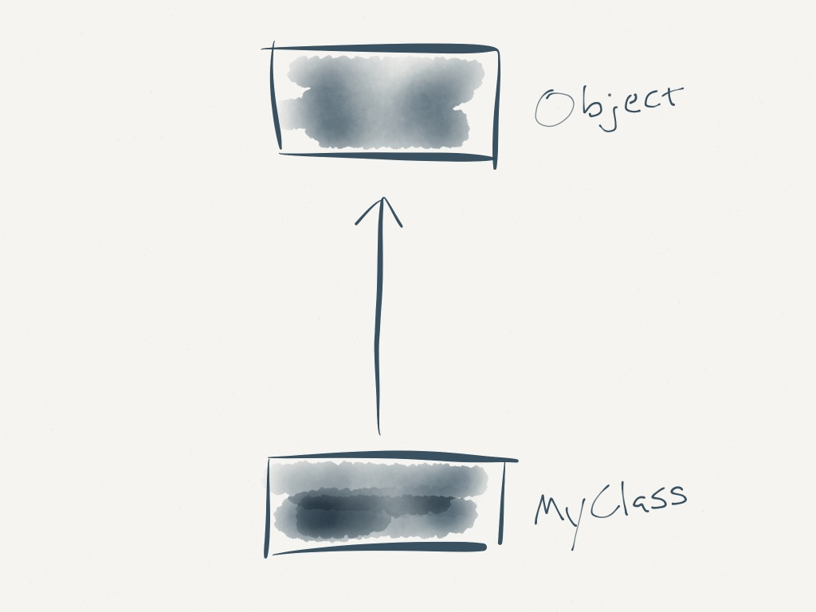

Slide 18
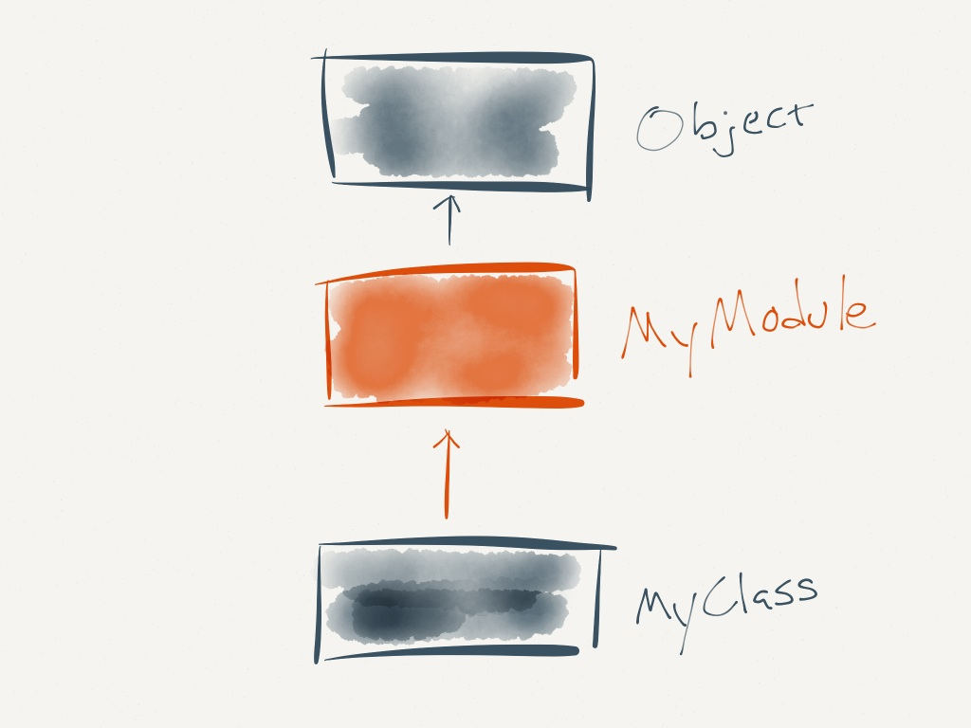

Slide 19

Class
Macros
Notes:
Class methods that define multiple methods or augmented methods of the class
We’ll understand attr_accessor

Slide 20
attr_accessor

Slide 21
class MyClass
def attribute
@attribute
end
def attribute= attribute
@attribute = attribute
end
end

Slide 22
class MyClass
attr_accessor :attribute
end

Slide 23
class MyClass
puts "Hi"
end
# => "Hi"
Notes:
The final piece: A class definition is just code that’s immediately executed, unlike many other languages where class definitions are essentially declarative.

Slide 24
define_method

Slide 25
class Loquacious
def say_hi(name)
puts "Going to say_hi"
puts "hi, #{name}!"
puts "Done with say_hi"
end
def say_bye(name)
# etc, etc, etc
end
end

Slide 26
class Loquacious
def self.def_notify_method(m, &block)
define_method m do |*args|
puts "Going to #{m}"
block.call(*args)
puts "Done with #{m}"
end
end
def_notify_method :say_hi do |name|
puts "hi, #{name}"
end
end
Notes:
Identify patterns in methods!

Slide 27
module Chatty
def def_notify_method(name, &block)
define_method m do |*args|
puts "Going to #{m}"
block.call(*args)
puts "Done with #{m}"
end
end
end

Slide 28
class Loquacious
extend Chatty
def_notify_method :say_hi do |name|
puts "hi, #{name}"
end
end

Slide 29
Dynamic Dispatch

Slide 30
Object#send

Slide 31
person.name = hash[:name]
person.email = hash[:email]
person.title = hash[:title]
person.age = hash[:age]
person.height = hash[:height]
person.phone = hash[:phone]

Slide 32
hash.each do |key,value|
person.send("#{key}=", value)
end

Slide 33

Ghost
Methods

Slide 34
method_missing
Notes:
Respond to many methods that follow a pattern but you don’t know that names at the time you’re writing the code
Super powerful
Create methods out of thin air
Code dismissed as magic

Slide 35

MAGIC?
Notes:
When used with care and consideration, method_missing can make your code more flexible and easy to use
But when used or abused in the wrong situation it can make your code more difficult to read and debug
Hard to know where a method call is handled
Does have the ability to appear to create methods out of thin air
But follows some fairly simple rules

Slide 36
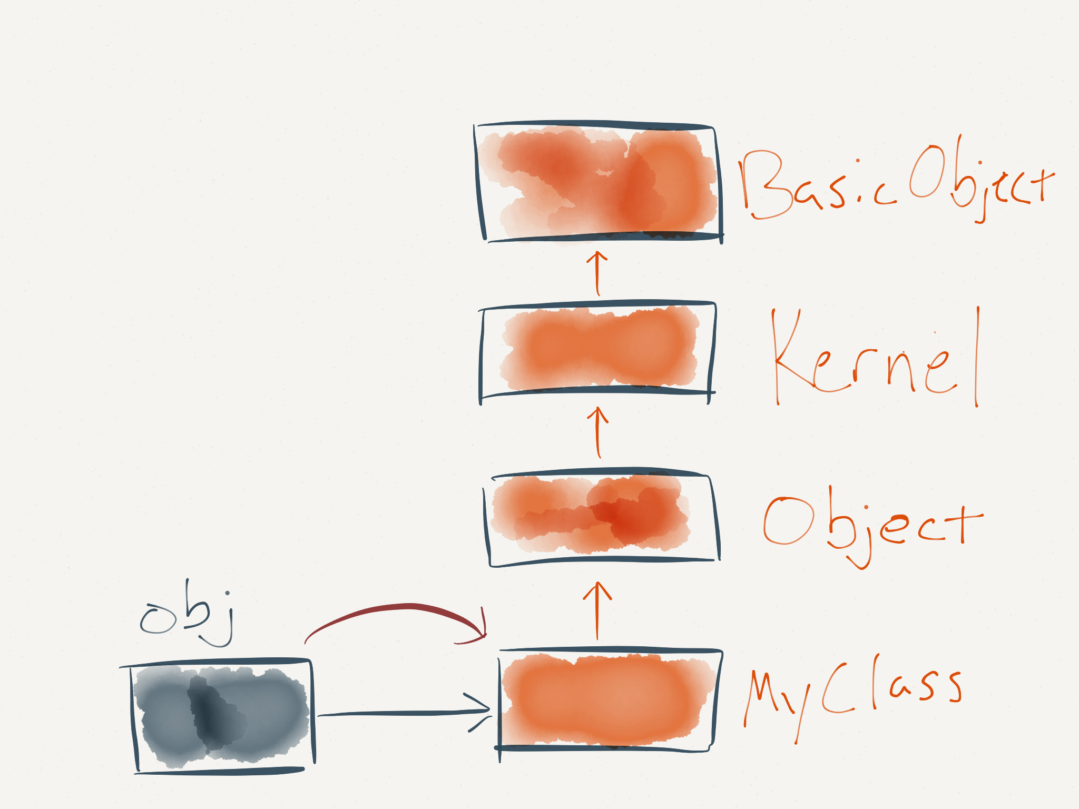

Slide 37

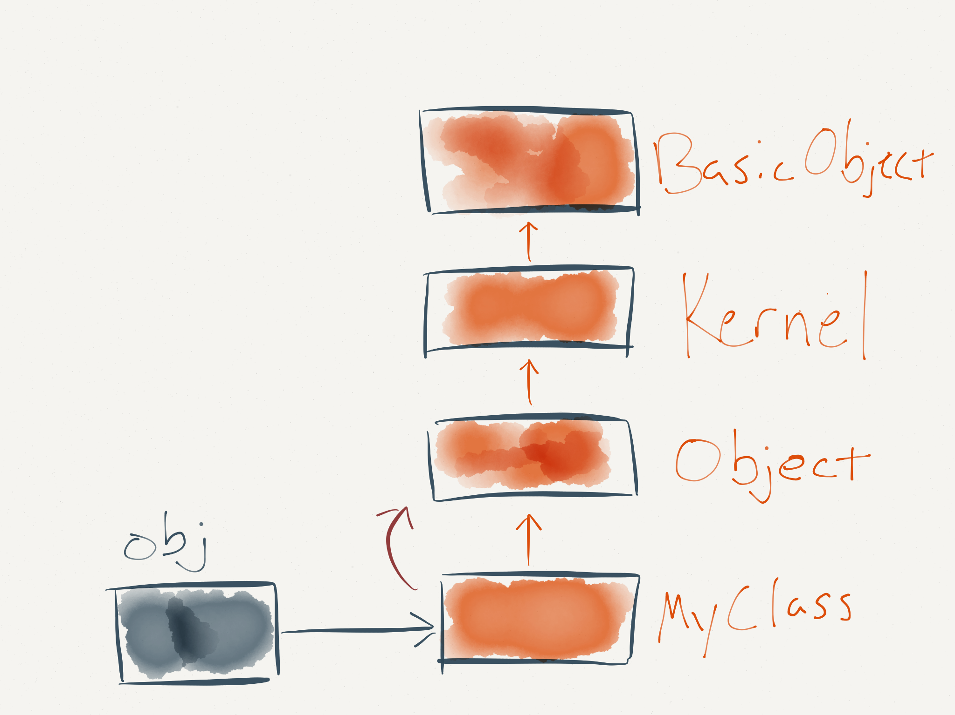

Slide 38


Slide 39


Slide 40
NoMethodError

Slide 41
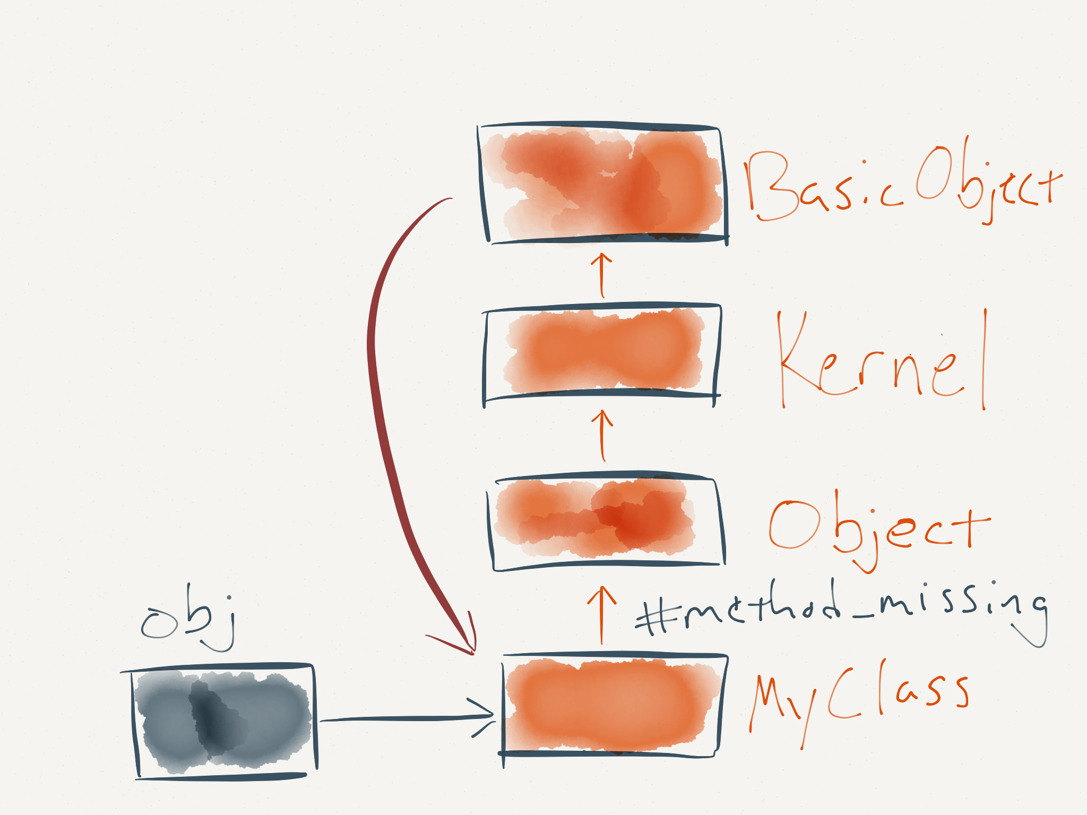
Notes:
Kernel#method_missing

Slide 42
require 'builder'
builder = Builder::XmlMarkup.new
builder.person { |p|
p.name "Link"
p.home "Hyrule"
}
# => "<person><name>Link</name><home>Hyrule</home></person>"
Notes:
Code is structurally similar to the data it produces

Slide 43
class DynamicProxy
def method_missing(m, *args)
uri = URI.parse(
"http://example.com/#{m}")
Net::HTTP.get_response(uri)
end
end
DynamicProxy.new.users
# => returns data from
# http://example.com/users

Slide 44

Notes:
Ok, so now we know what metaprogramming is and we’ve seen a few examples of what it can do for us.
Everything is great right?
Well, Ruby gives us these powerful tools but sometimes they need a warning label. Ruby trusts developers and lets us play with the sharp scissors but it’s up to us to remember not to run with them.
Let’s look at a few examples of how these can trip us up

Slide 45
No Surprises

Slide 46
class Foo
def method_missing name
return name == :miss || super
end
end
foo = Foo.new
foo.miss # => true
foo.respond_to? :miss
# => false

Slide 47
def respond_to? name
return name == :miss || super
end
foo.respond_to? :miss # => true
foo.method :miss
# => NameError: undefined method
# 'miss' for class 'Foo'

Slide 48
def respond_to_missing? name, *arg
return name == :miss || super
end
foo.method :miss
# => #<Method: Foo#miss>
Foo.instance_methods.grep(/miss/)
# => [:method_missing,
# :respond_to_missing?]

Slide 49

REMEMBER
TO CALL
SUPER

Slide 50
Performance

Slide 51
class MethodMissing
def method_missing(name, *args)
return super unless\
(name =~ /a_method/)
end
end

Slide 52
class DefMethod
def self.add_method name
define_method name do |*args|
nil
end
end
add_method :a_method
end
Notes:
Slower because the method body block is a closure with it’s own bindings and is harder to optimize than a method call

Slide 53
class Normal
def a_method
nil
end
end

Slide 54
m1 = MethodMissing.new
m2 = DefMethod.new
m3 = Normal.new
Benchmark.bm do |x|
x.report {50000.times {m1.a_method}}
x.report {50000.times {m2.a_method}}
x.report {50000.times {m3.a_method}}
end

Slide 55
(user)
method_missing 0.230000
define_method 0.040000
def 0.020000

Slide 56
class MethodMissing
def method_missing(name, *args)
return super unless\
(name =~ /a_method/)
self.class.class_eval do
define_method name do
nil
end
end
end
end

Slide 57
method_missing 0.230000
cache method_missing 0.020000
def 0.020000

Slide 58
class DefMethod
def self.add_method name
eval """
def #{name}
nil
end
"""
end
add_method :a_method
end

Slide 59
define_method 0.040000
eval + def 0.020000
def 0.020000
Notes:
So why would we ever use define_method and not eval?
The method definition with eval is actually much slower
Additionally, there’s a reason that’s covered in our next topic:

Slide 60
Security
Notes:
With eval if there is any way at all that the name of the method could be provided from untrusted input, we have a problem.
A recent Rails vulnerability was actually related to something similar
We may not have a problem today but if our code is used by other code as the layers of code grow it can be harder and harder
To be sure that there’s no way for untrusted input to reach us

Slide 61

EVAL
Notes:
eval

Slide 62
class DefMethod
def self.add_method name
eval """
def #{name}
nil
end
"""
end
add_method :a_method
end

Slide 63
class Proxy
def initialize(server, arg1, meth)
@server = server
@arg1 = arg1
@meth = meth
end
def method_missing(mid, *args)
@server.send(@meth, @arg1,
*args)
end
end
Credit: http://tenderlovemaking.com/2013/02/06/yaml-f7u12.html

Slide 64
obj.send(:eval,
"puts :lolhax")
Notes:
In the class_eval case: Are you positive that no one can provide the name of the method being defined? The recent Rails security vulnerabilities have shown that when code in libraries is used many layers deep in a framework it can be really difficult to make sure that there isn’t some case where untrusted input can reach it.

Slide 65
public_send
RESPECT PRIVACY

Slide 66

METAPROGRAMMING
Notes:
Closing: Say Expressive!
Create “keywords” with class macros
Call many different methods with the same code with Dynamic Dispatch
Create methods out of thin air with Ghost Methods
These are only a few…
Encourage you to experiment…

Slide 67
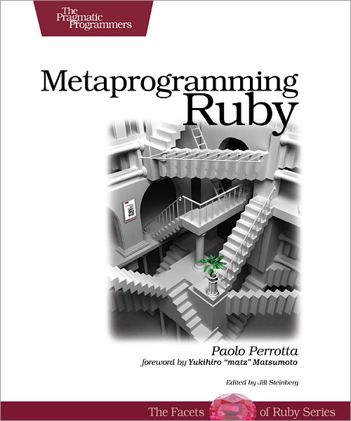

Slide 68

Episode 012 – Metaprogramming
Episode 080 – Practical Metaprogramming
with Steven Harms

Slide 69
References
Metaprogramming in Ruby: It’s All about The Self
Method_missing, Politely
Seeing Metaclasses Clearly
Why Metaprogram When You Can Program?

Slide 70
Slides:
github.com/willgorman/going-meta

Slide 71

http://drmcninja.com

